Slide 1
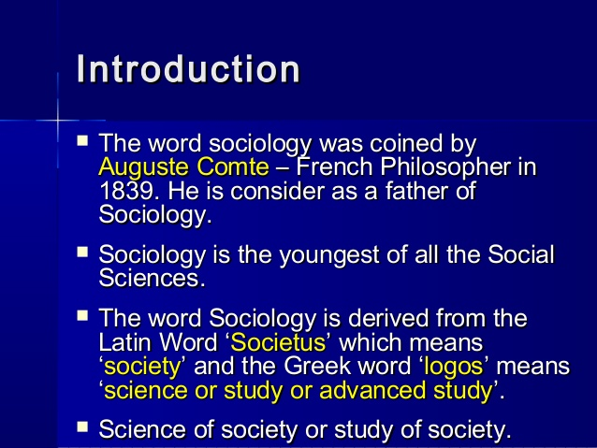
Concept of Social Perspectives in Education
Sociology
Sociology is the study of society. In other words it is the science of society. Auguste Comte is credited for the establishment of this discipline. So, he is called the father of sociology.

Slide 2
Sociology is studied as a separate discipline. This subject shows the social life, social relation and social organizations.
Other popular sociologists are Emile Durkheim, Max Weber, Herbert Spencer, J.S. Mill and so on.

Slide 3
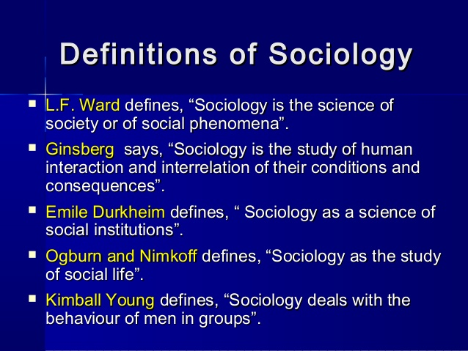

Slide 4
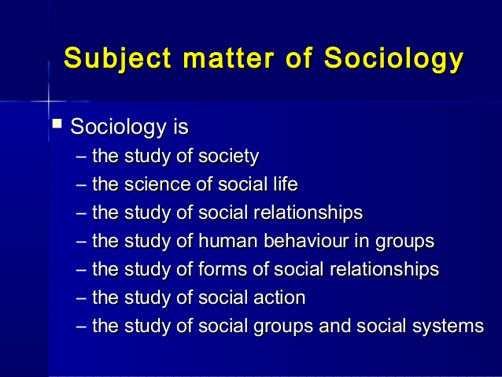

Slide 5
Social Perspectives of Education
Education is a process which exists within a society. Education is organized in the society by individuals who are members of a particular group, community, states and nation. So, we can understand the significance of the society in educational process and organizing curricular events.

Slide 6


Slide 7
Sociological perspectives in education (Sociological theories of education) lzIffdf ;dfhzf:qsf lz4fGtx?sf] k|efj
Theory means different things to different people. It could be defined as a conceptual scheme designed to explain observed regularities or relationships between two or more variables. Theoretical perspectives are used to provide logical explanation for why things happen the way they do. There are always various interpretations of events in our everyday life. Similarly there are several sociological perspectives on why things happen the way they do in society. These theories result in different interpretations of the same information because they focus on different aspects.

Slide 8
Cont…
The sociology of education is the study of how social institutions and individual experiences affect education and its outcome. It is concerned with all forms of education i.e. formal and informal education systems of modern industrial societies. It is relatively a new branch and two great sociologists Émile Durkheim and Max Weber were the father of sociology of education. Émile Durkheim's work on moral education as a basis for social solidarity is considered the beginning of sociology of education.

Slide 9
Cont…
More importantly, sociologist began to think that education promotes social mobility and undermine the class stratification. After the Second World War it gained entity as separate subject of knowledge. Technological advancement and engagement of human capital(work force) in industrialization America and Europe gave rise to the social mobility .Now it is easier to move up to the upper strata (layer) of society gaining technical skills, knowledge. People who were farmer earlier became worker in factories.

Slide 10
Cont…
As a school teacher and administrator all of you are living in a small society known as school. You will find various relation (learner and teacher, peer group, boys and girls, different social background etc), values(religion and culture) in educational institutions. So we must know the pattern, concerns of this society for effective educational outcome.

Slide 11
Cont…
The relation between sociology and education has always been a subject of debate. One concept says education is meant to overcome the inequalities of society whereas the other says the prime function of education is to promote the equilibrium (balance) status of the society, i.e. it tries to maintain equality/inequality.

Slide 12
Concept of Sociology of education
Sociology of Education is the scientific analysis of the social processes and social patterns involved in the educational system .It is the study of how social institutions and forces affect educational processes and outcomes and vice versa. In sociology of education, one learns about the effects of government and individual behaviors in the field of education.

Slide 13
'The sociology of education is defined as the scientific study of the analysis of the social processes and social patterns involved in the educational system'. (W.B. Brookover)

Slide 14
Contents of sociology of education
Content refers to the area of scope. Morris has mentioned the following areas involved in the sociology of education.
The effect of the economy upon education
The social forces and determinants that affect educational and cultural change
The social institutions involved in the educational process, such as family and school

Slide 15
Cont…
Various problems of role structure of social system and school
The relationship between social class, culture and language
Problems of embourgeoisment , democratization and elitism
Relationship between education and occupation
Questions of curriculum building and development of subcultures.
Problems associated with school

Slide 16
Sociological perspectives in education (Sociological theories of education)
We are going to take a look at the key aspects of the following theories which have made major contribution to the field of sociology of education:
Structural-functional
Conflict
Symbolic interaction

Slide 17
Structural functionalists
Structural Functionalism is a sociological theory that attempts to explain why society functions. This theory focuses on the relationships between the various social institutions that make up society (e.g., government, law, education, religion, etc).Structural functionalists believe that society exists in social order.

Slide 18
Cont…
They see society like a human body, in which each part plays a role and all are dependent on each other for survival. Institutions such as education are like important organs that keep the society/body healthy and well

Slide 19
Structural functionalists believe the aim of key institutions, such as education, is to socialize children and teenagers (bringing them in the structure/system). It is the process by which the new generation learns the knowledge, attitudes and values that they will need as productive citizens. Although this aim is not stated in the formal curriculum, it is mainly achieved through "the hidden curriculum".

Slide 20
Cont…
The other purpose of education is to sort and rank individuals for placement in the labour market. Those with high achievement will be trained for the most important jobs and in reward, be given the highest incomes.

Slide 21
Key principle of Structural functionalists are as below
Interdependency
Function of social structure and cultural
Consensus and co-operation
Equilibrium

Slide 22
CRITICISM OF FUNCTIONALISM
Functionalism fails to recognize the number of divergent interests, ideologies and conflicting interest groups in society. In heterogeneous societies each sub-group may have its own agenda to further its own interests.
It is difficult to analyze individual interactions such as classroom dynamics of teacher-student or student-student interactions from this perspective.
It does not deal with the ‘content’ of the educational process- what is taught and how it is taught.
Individuals do not merely carry out roles within the structure, they create and modify them.

Slide 23
CONFLICT THEORY
The conflict theory, suggested by Karl Marx, claims society is in a state of continuous conflict because of competition for limited resources. It holds that social order is maintained by domination and power, rather than consensus and conformity. According to conflict theory, those with wealth and power try to hold on to it by any means possible, chiefly by suppressing the poor and powerless

Slide 24
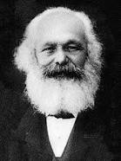
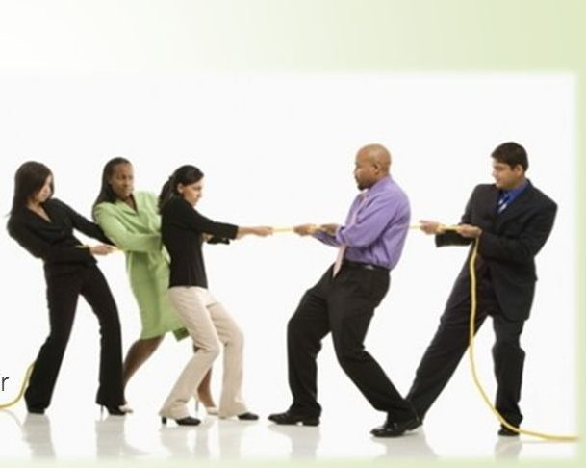
Karl Marx believes that society is full of social groups. In this view, relations in society are mainly based on exploitation, oppression, domination and subordination.
Karl Marx

Slide 25
The Marxist conflict approach emphasizes a materialist interpretation of history, a dialectical method of analysis, a critical position toward existing social arrangements, and a political program of revolution or, at least, reform. Education legitimizes ‘acceptable’ ideas which actually work to reinforce the privileged positions of the dominant group.

Slide 26
Education maintains the status quo, where lower-class children become lower class adults, and middle and upper class children become middle and upper-class adults.
Education maintains the status quo, where lower-class children become lower class adults, and middle and upper class children become middle and upper-class adults.
McLeod argues that teachers treat lower-class kids like less competent students. He pacing them in lower class.

Slide 27
They point out that while private schools are expensive and generally reserved for the upper classes, public schools- like Municipal schools, especially those that serve the poor, are under - funded, understaffed, and growing worse
Schools are also powerful agents of socialization that can be used as tools for one group to apply power over others – for example, by demanding that all students learn English, schools are ensuring that English-speakers dominate students from non-English speaking backgrounds.

Slide 28
Teachers assume that students will have particular middle class experiences at home. For some children this assumption isn‘t necessarily true. Some children are expected to help their parents after school and carry considerable domestic responsibilities in their often single-parent home.
The demands of this domestic labour often make it difficult for them to find time to do all their homework and this affects their academic performance.

Slide 29
The students realize there is little or no direct link between the subjects they are doing and their perceived future in the labour market.
Anti-school values are displayed by these children.
With ‘education’, rich children perform better, achieve higher and obtain greater rewards. In this way, the continuation of privilege and wealth for the elite is made possible.
Conflict theorists believe this social reproduction continues to occur because the whole education system is overlain with ideology provided by the dominant group.

Slide 30
SYMBOLIC INTERACTIONISM
Symbolic interactionism, or interactionism for short, is one of the major theoretical perspectives in sociology. Beginning with the German sociologist and economist, Max Weber (1864-1920) and the American philosopher, George H. Mead (1863-1931), both of whom emphasized the subjective meaning of human behavior, the social process, and pragmatism. Herbert Blumer, who studied with Mead at the University of Chicago, is responsible for coining the term, "symbolic interactionism," as well as for making the most prominent version of the theory.

Slide 31
Symbolic interactionism is a school of thought in sociology that explains social behavior in terms of how people interact with each other via symbols; in this view, social structures are best understood in terms of such individual interactions. Mead believed that one's self develops through social interactions. Moreover, how people communicate and interact with each other depends on how they interpret factors such as language, actions, and statuses (potential symbols).

Slide 32
For example, one might interpret a handshake as either a friendly greeting or cool farewell, depending on context (the symbolism of a handshake varies). Sometimes symbols change; long hair in males once symbolized rebellion, but now does not.
Interactionists focus on the subjective aspects of social life, rather than on objective, macro-structural aspects of social systems.
Notes:
https://sciencestruck.com/the-concept-of-symbolic-interactionism-in-sociology-with-examples

Slide 33
Basic Principles
1. Humans have capacity for thought.
2. Thought is shaped by social interaction.
3. Through interaction, people learn symbols and meanings that allow them to think.
4. Meanings and symbols allow for human action.
5. People can interpret a situation and modify their action or interaction.
6. People can create own meanings.
7. Groups and societies are made up of patterns of action and interaction.

Slide 34
Charles Horton Cooley (1864-1929)
“The looking glass self”
George Herbert Mead (1863-1931
Main ideas:
The shape of “Me” is composed of the messages we receive by using others as mirrors of the self.

Slide 35
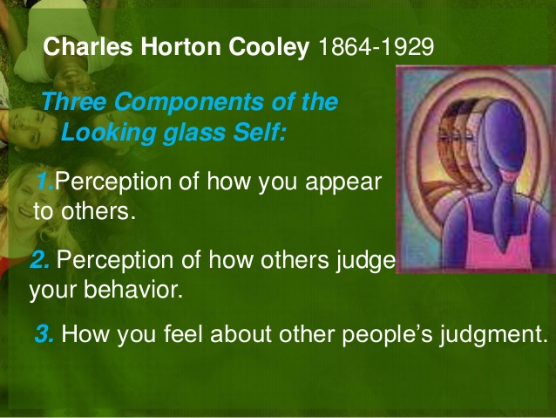

Slide 37
Socialization
The act of adapting behavior to the norms of a culture or society is called socialization. Socialization can also mean going out and meeting people or hanging out with friends.
Learning the customs, attitudes, and values of a social group, community, or culture. Socialization is essential for the development of individuals who can participate and function within their societies, as well as for ensuring that a society's cultural features will be carried on through new generations. Socialization is most strongly enforced by family, school, and peer groups and continues throughout an individual's lifetime.
Notes:
What is the importance of the process of socialization in our life?

